Slide 1
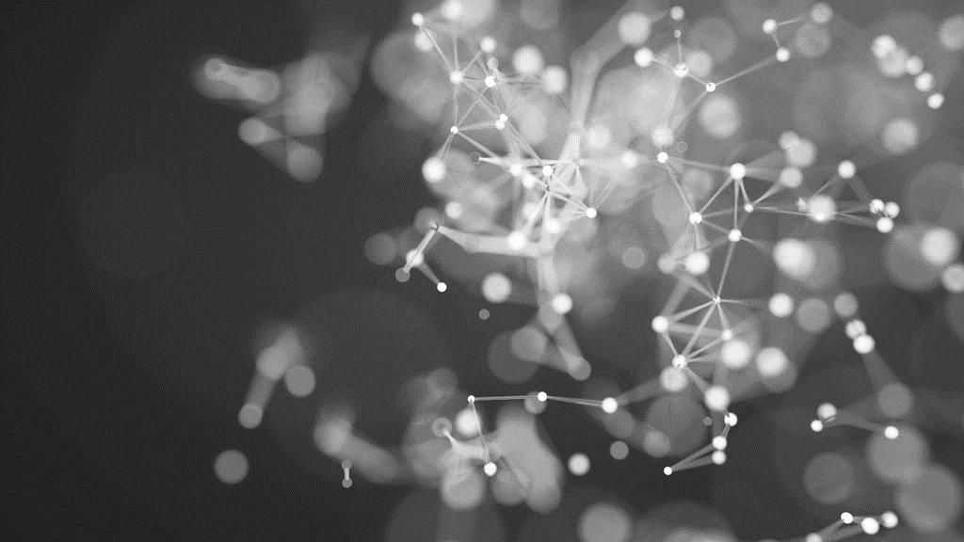
Emotion Recognition in Customer Service Team-B
Manasa Vasupali
Lakshmi Prasana Pothuganti
Veditha Lakshmi Yechuri

Slide 2
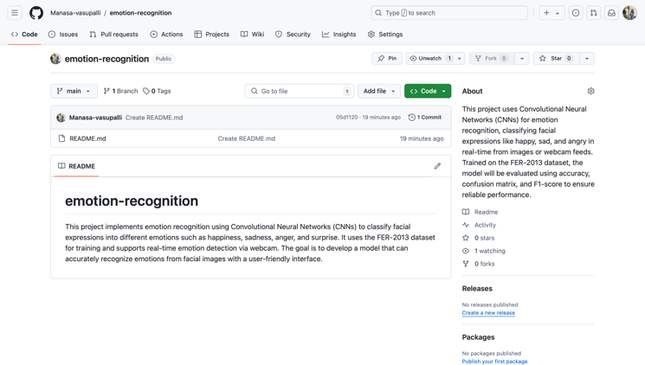
Kaggle Id : manasavasupalli
Github Repo link :
https://github.com/Manasa-vasupalli/emotion-recognition

Slide 3
TABLE OF CONTENTS
Introduction
Source Dataset details
State of Art
Effective delivery techniques
Data Analysis
Mean and Variance of Dataset
CNN Model
Quantum Models
PENNYLANE Model
Final Model
Summary

Slide 4

INTRODUCTION
Definition: Emotion recognition technology utilizes facial expression analysis to identify and interpret customer emotions.
Enhancing Customer Experience: By detecting real-time emotions like happiness or frustration, companies can adjust their responses to better suit the customer's emotional state.
Improved Support: Emotion recognition allows customer service agents to tailor their interactions, leading to faster problem resolution and a more empathetic approach.
Benefits to Companies:
Increases customer satisfaction and loyalty.
Strengthens communication between the company and customers, fostering a sense of value and care
Overall Impact: Integrating emotion recognition enhances service quality, leading to more positive customer experiences and improved service outcomes.

Slide 5
Objectives
Develop a robust CNN for emotion classification.
Address dataset imbalances with augmentation.
Explore quantum techniques for optimization.
Implement real-time detection with webcam integration.

Slide 6
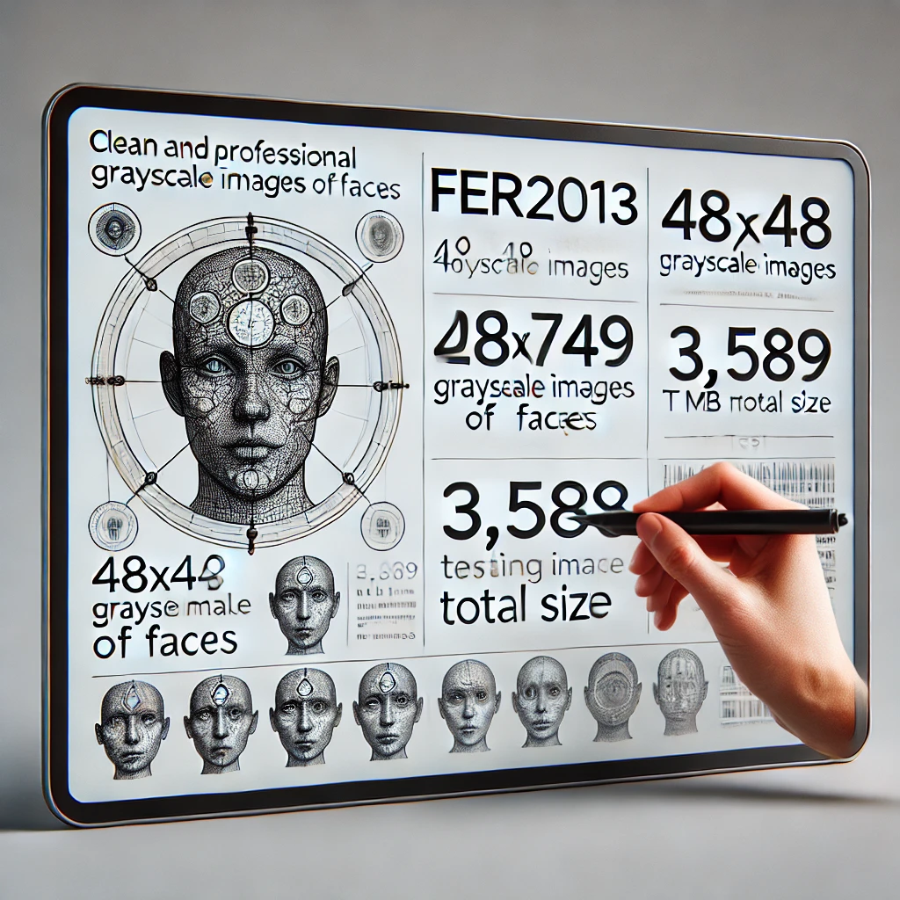
Dataset
Dataset links :
https://www.kaggle.com/datasets/msambare/fer2013/data
https://www.kaggle.com/datasets/sudarshanvaidya/random-images-for-face-emotion-recognition
The dataset includes 48x48 pixel and 224x224 grayscale images of faces.
Each face is centered and takes up a similar amount of space in every image.
The training set has 28,965 images to learn from, and the public test set has 7,361 images to check how well the model performs. The dataset is 56.51 MB and all together 36.3 K images.
7 emotion classes: anger, disgust, fear, happiness, neutral, sadness, surprise.
Challenges: Class imbalance addressed with data augmentation.
Supplementary Dataset: Enhanced 'disgust' class diversity.

Slide 7
State of art
USING CNN

Slide 8
Effective delivery techniques
Image Classification Using CNN and Quantum Neural Networks
CNN for Image Classification: The project utilizes Convolutional Neural Networks (CNN) to classify images, leveraging its strength in handling visual data.
Custom Dataset: We will develop and use our own dataset to test the model’s accuracy, ensuring the model is tailored to our specific application.
Quantum Neural Networks (QNN): The project stands out by integrating Quantum Neural Networks to enhance efficiency and performance. This will allow the model to process complex tasks faster.
Software and Tools:
Leap Software: QNN will be implemented using the Leap platform for quantum computing.
Visual Studio & Jupyter Notebook: For implementation, we will switch between Visual Studio and Jupyter Notebook, depending on the task and convenience.
Innovative Approach: The hybrid use of classical (CNN) and quantum (QNN) methods ensures that our project pushes the boundaries of current technology, improving speed and accuracy.

Slide 9
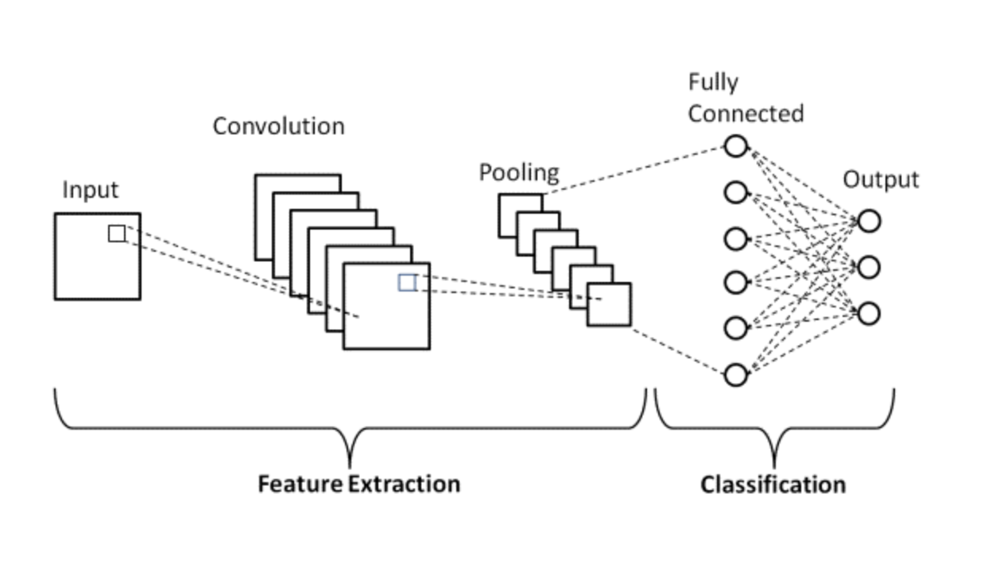
METHODOLOGY
CNN Architecture:
* Input: 48x48 grayscale images.
* Layers: Convolutional, MaxPooling, BatchNormalization, Dropout, Dense.
Quantum Techniques:
* QUBO for hyperparameter tuning and feature selection using Conbqa.
* Pennylane circuits for hybrid quantum-classical models.

Slide 10
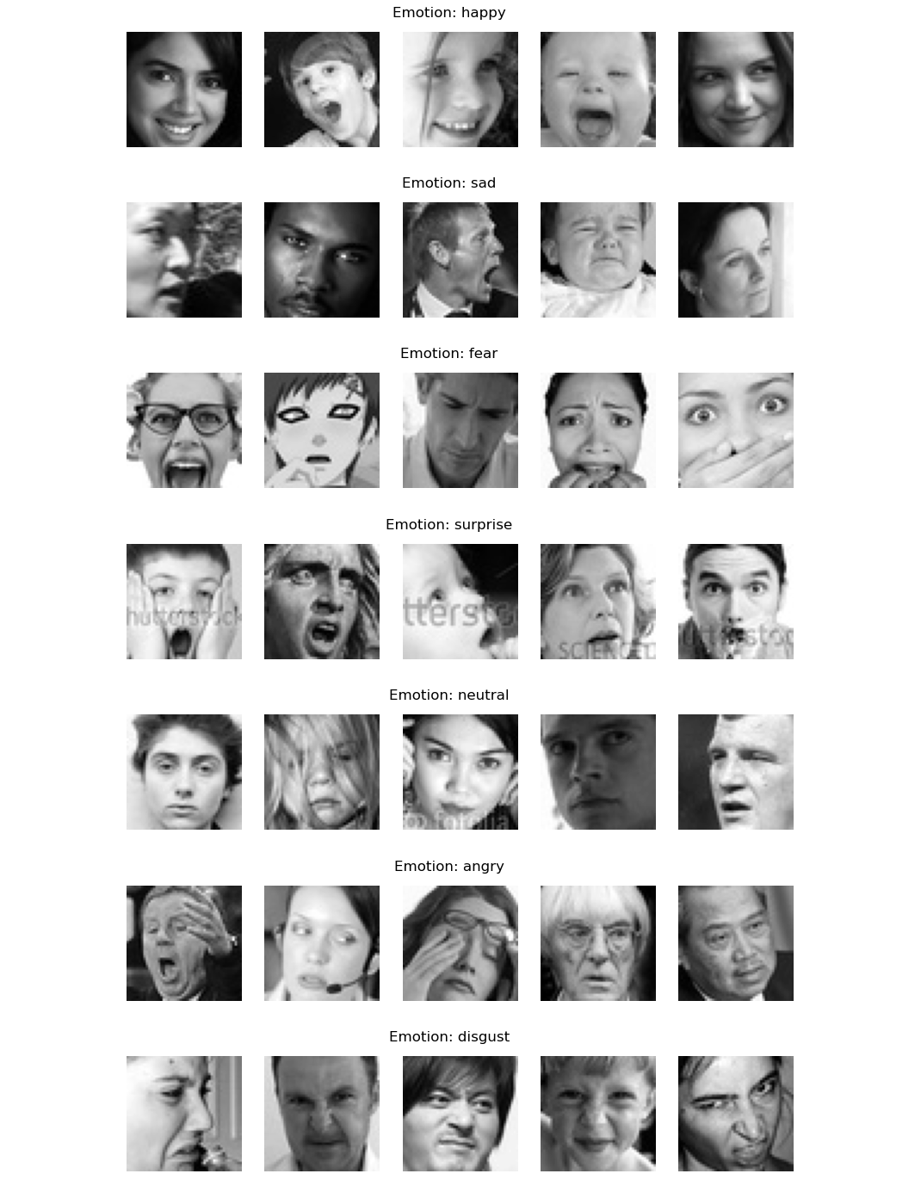
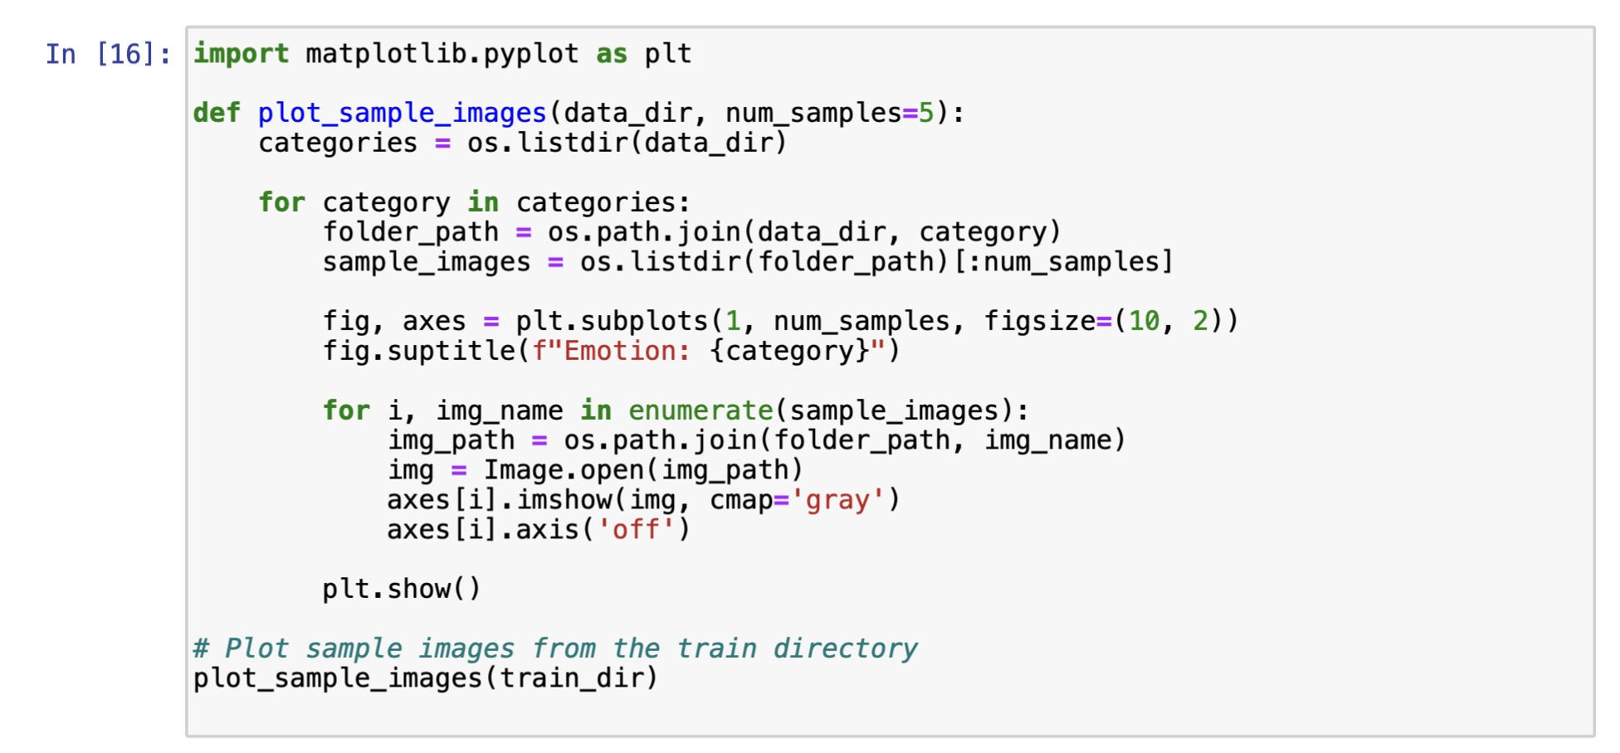
Code to print the sample images

Slide 11
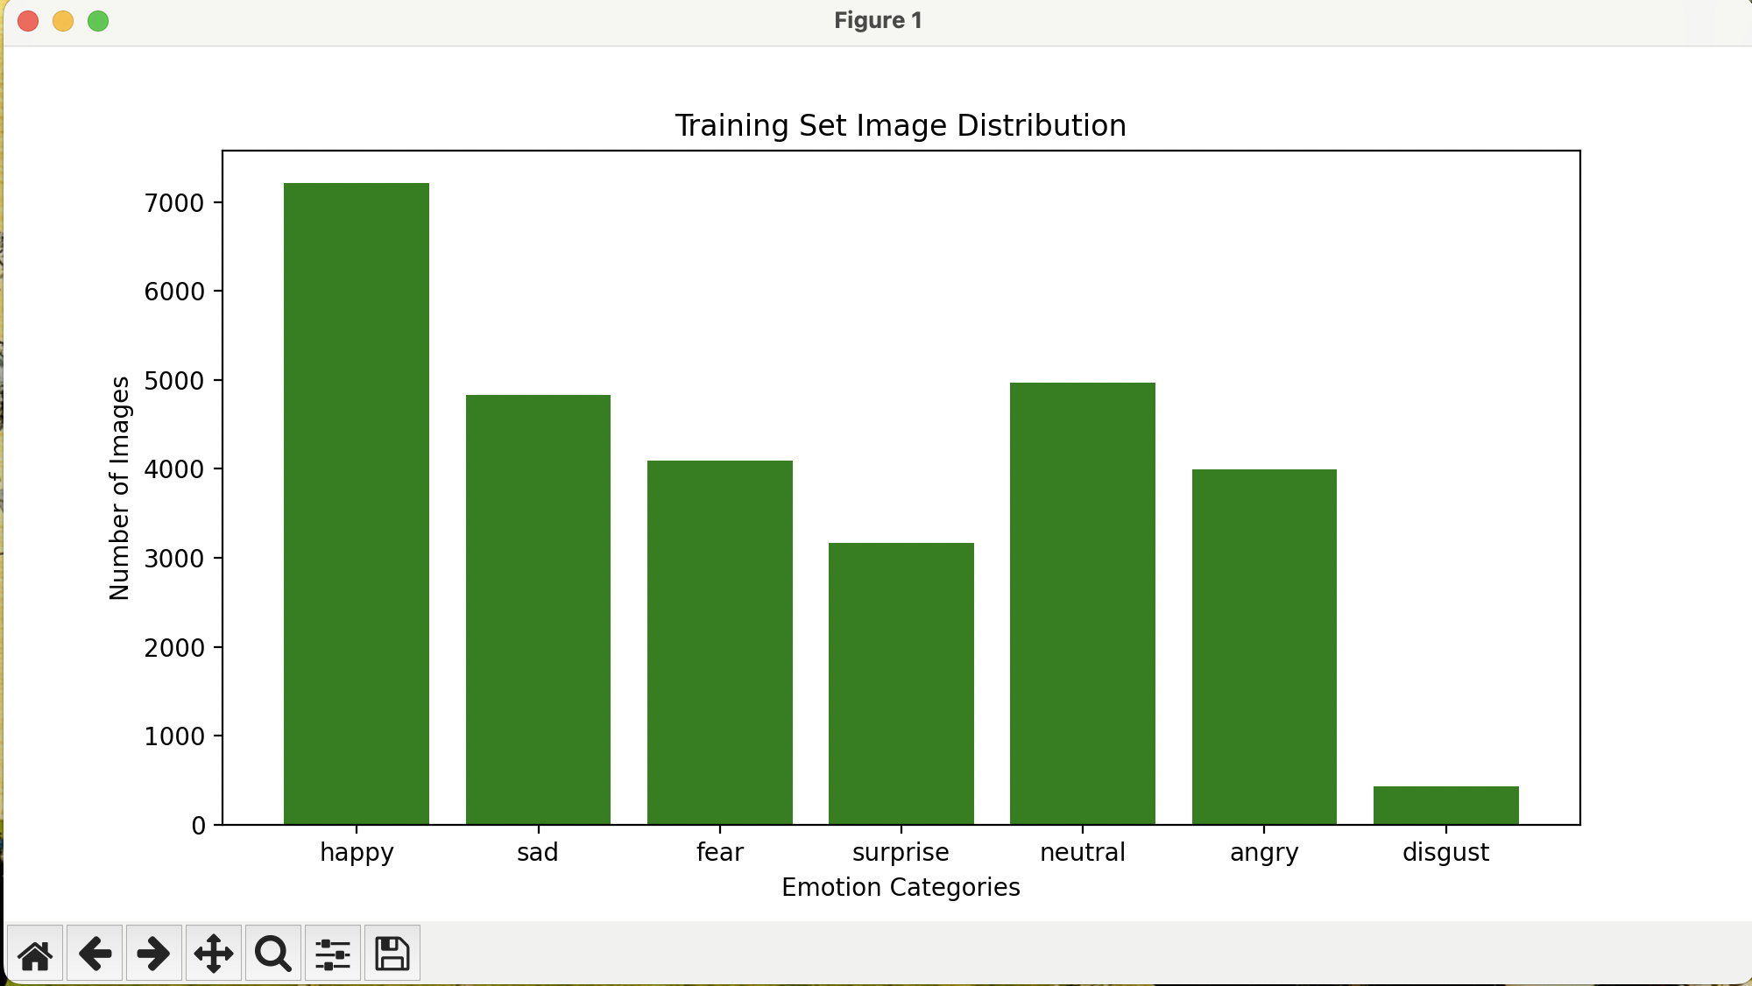
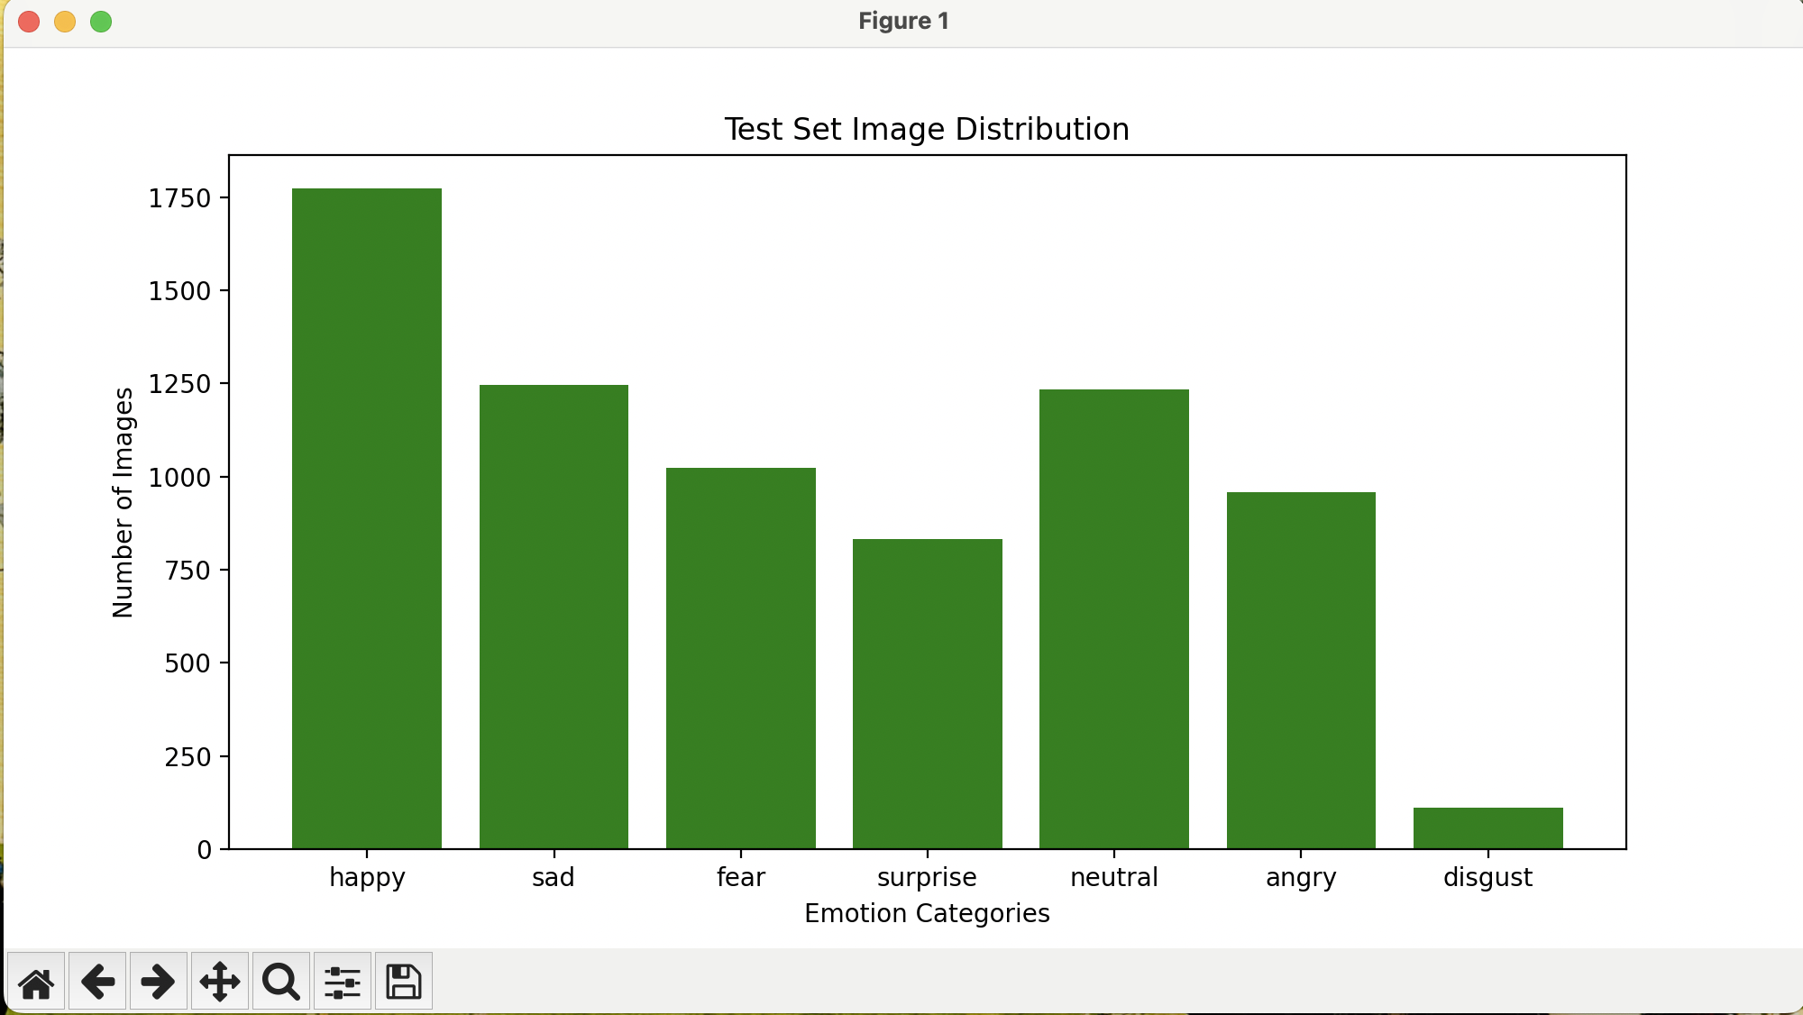
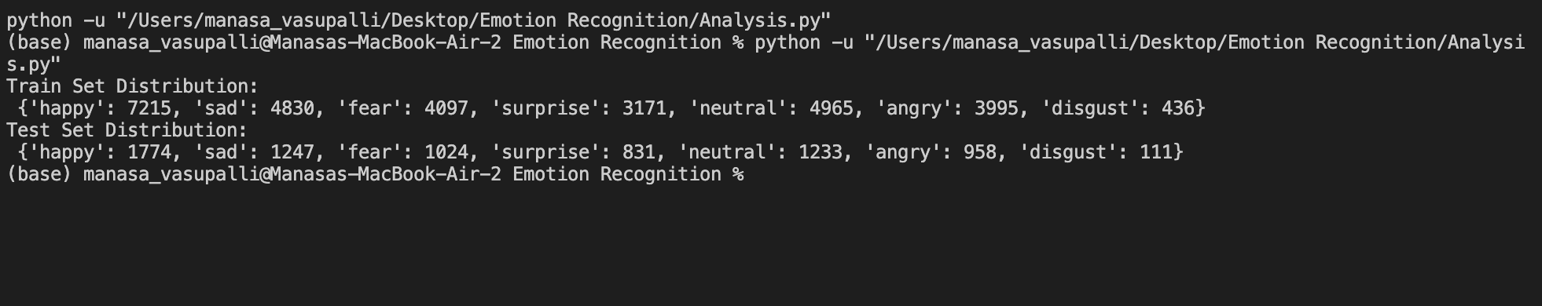
Data Analysis
Emotion Distribution in Training and Testing Data:
A bar plot was used to analyze the distribution of emotions.
Observation:
The dataset contains a larger number of "happy" images, while the "disgust" images are significantly fewer. The remaining emotions like "sadness," "anger," "surprise," and "neutral" are almost equally distributed.
Visualization of Attribute Distribution:
The bar plot below shows the frequency of each emotion in both the training and testing datasets.

Slide 12
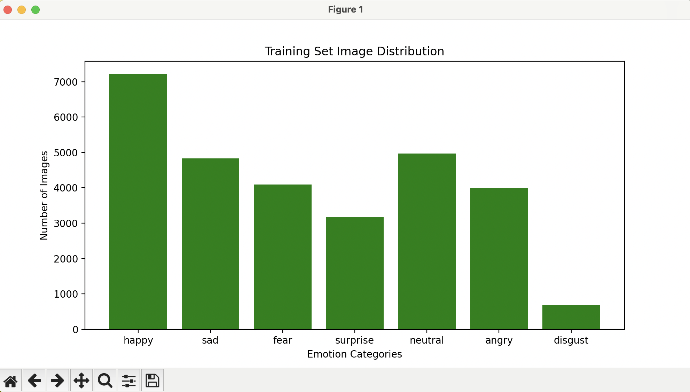
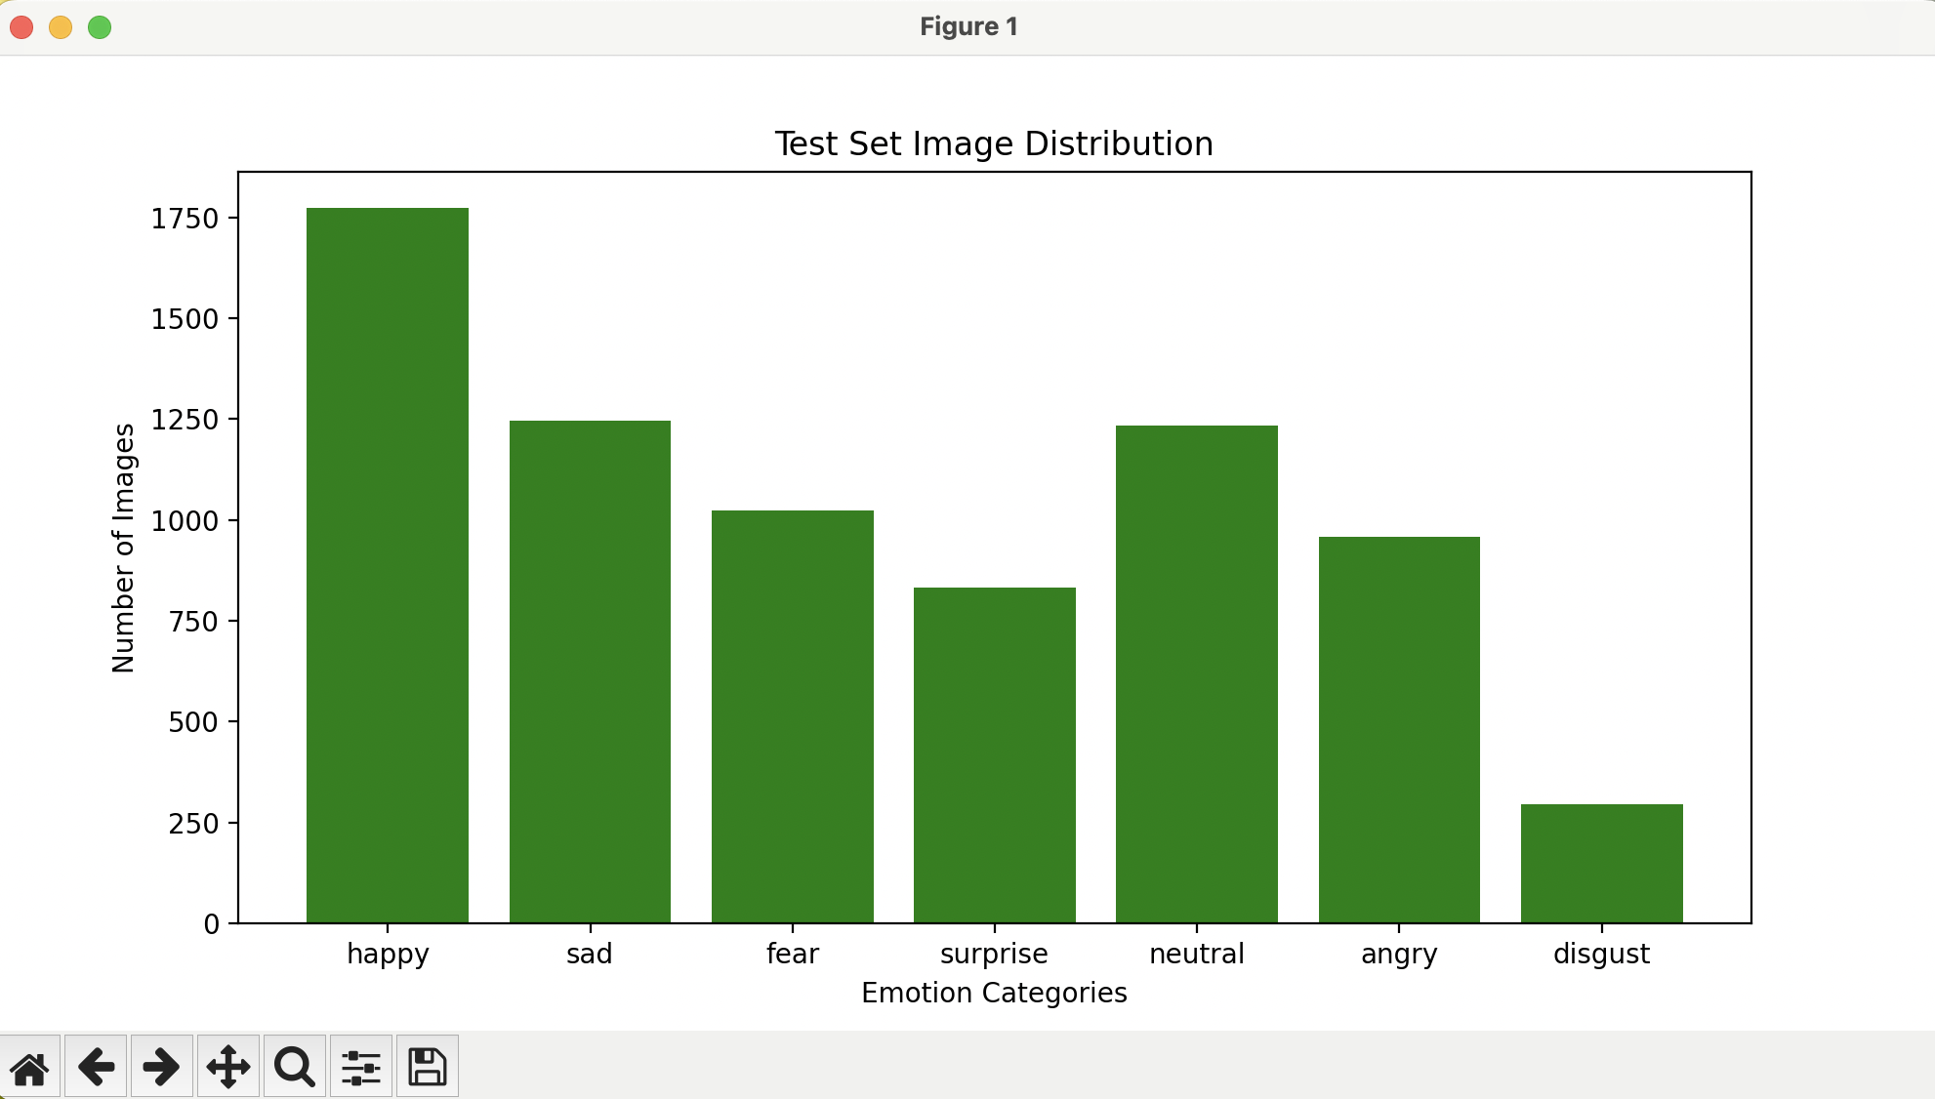
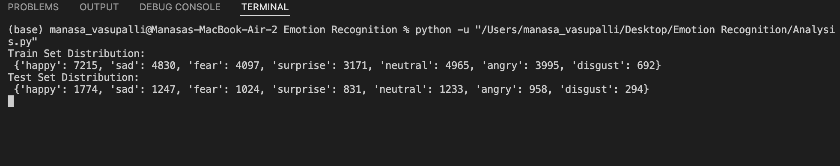
Data Analysis on new dataset

Slide 13
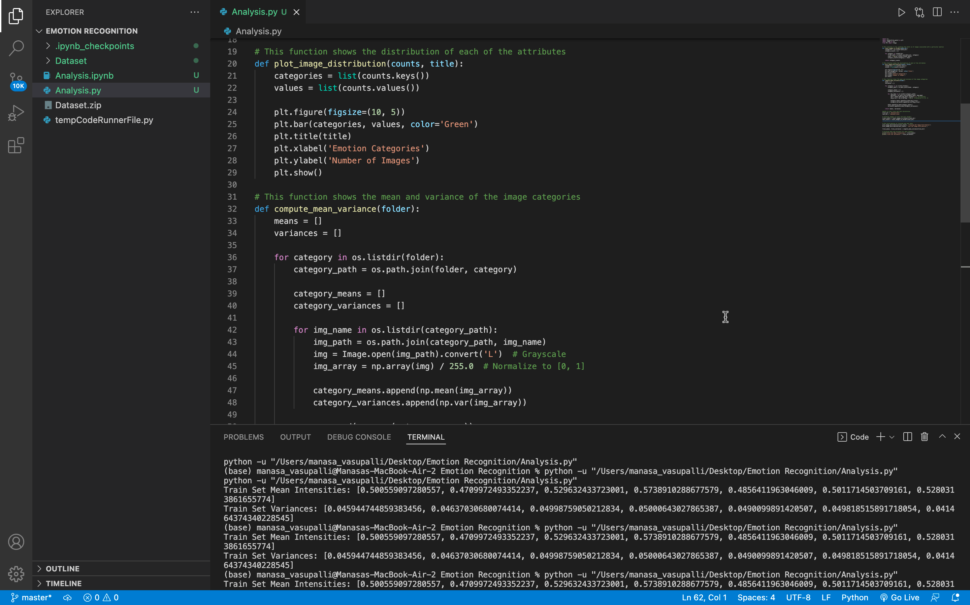
mean and variance of the dataset

Slide 14
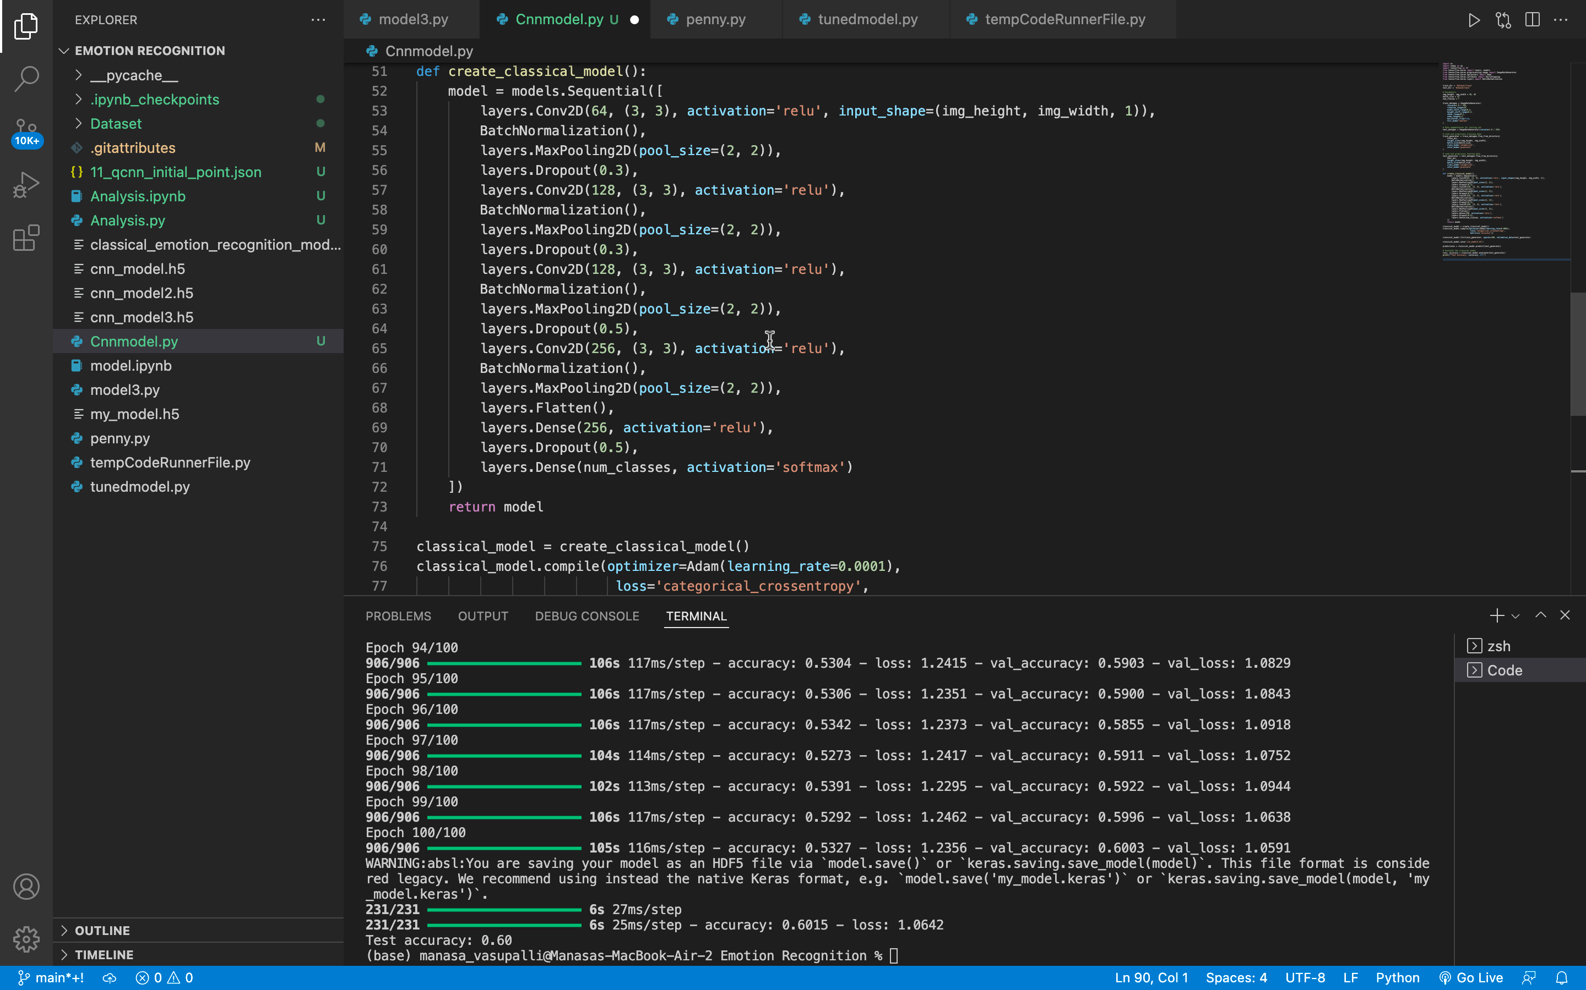
CNN model
Used 1 input layer, 3 hidden layers and 1 output layer .
Used BatchNormalization, Max Pooling , Dropouts .
Various architectures have been tried to get a good accuracy score .
Testing Data accuracy : 60 %

Slide 15
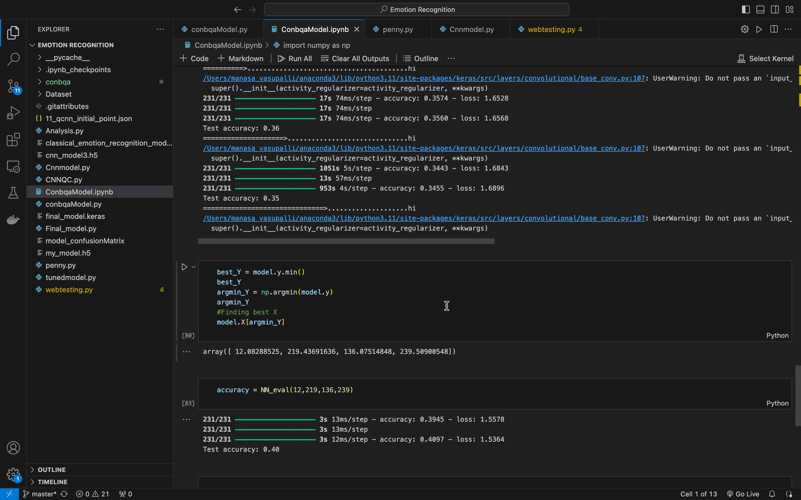
Quantum hyperparameter optimized model
Used Quadratic Unconstrained Binary Optimization (QUBO)
Experimented with Conbqa library.
Hyper-parameter tuning for number of neurons,
Classical CNN model with quantum tuned parameters.
Testing Data accuracy : 40 %

Slide 16
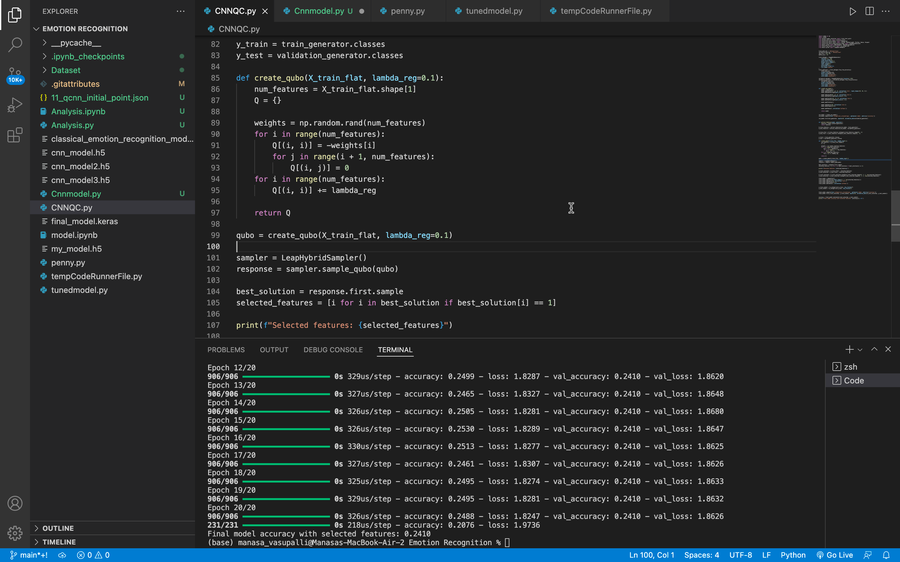
Quantum Feature selection model
Used Quadratic Unconstrained Binary Optimization (QUBO)
Imported Leap Hybrid Sampler
Feature Selection through quantum computing .
Classical CNN model with quantum selected features .
Testing Data accuracy : 24 %

Slide 17
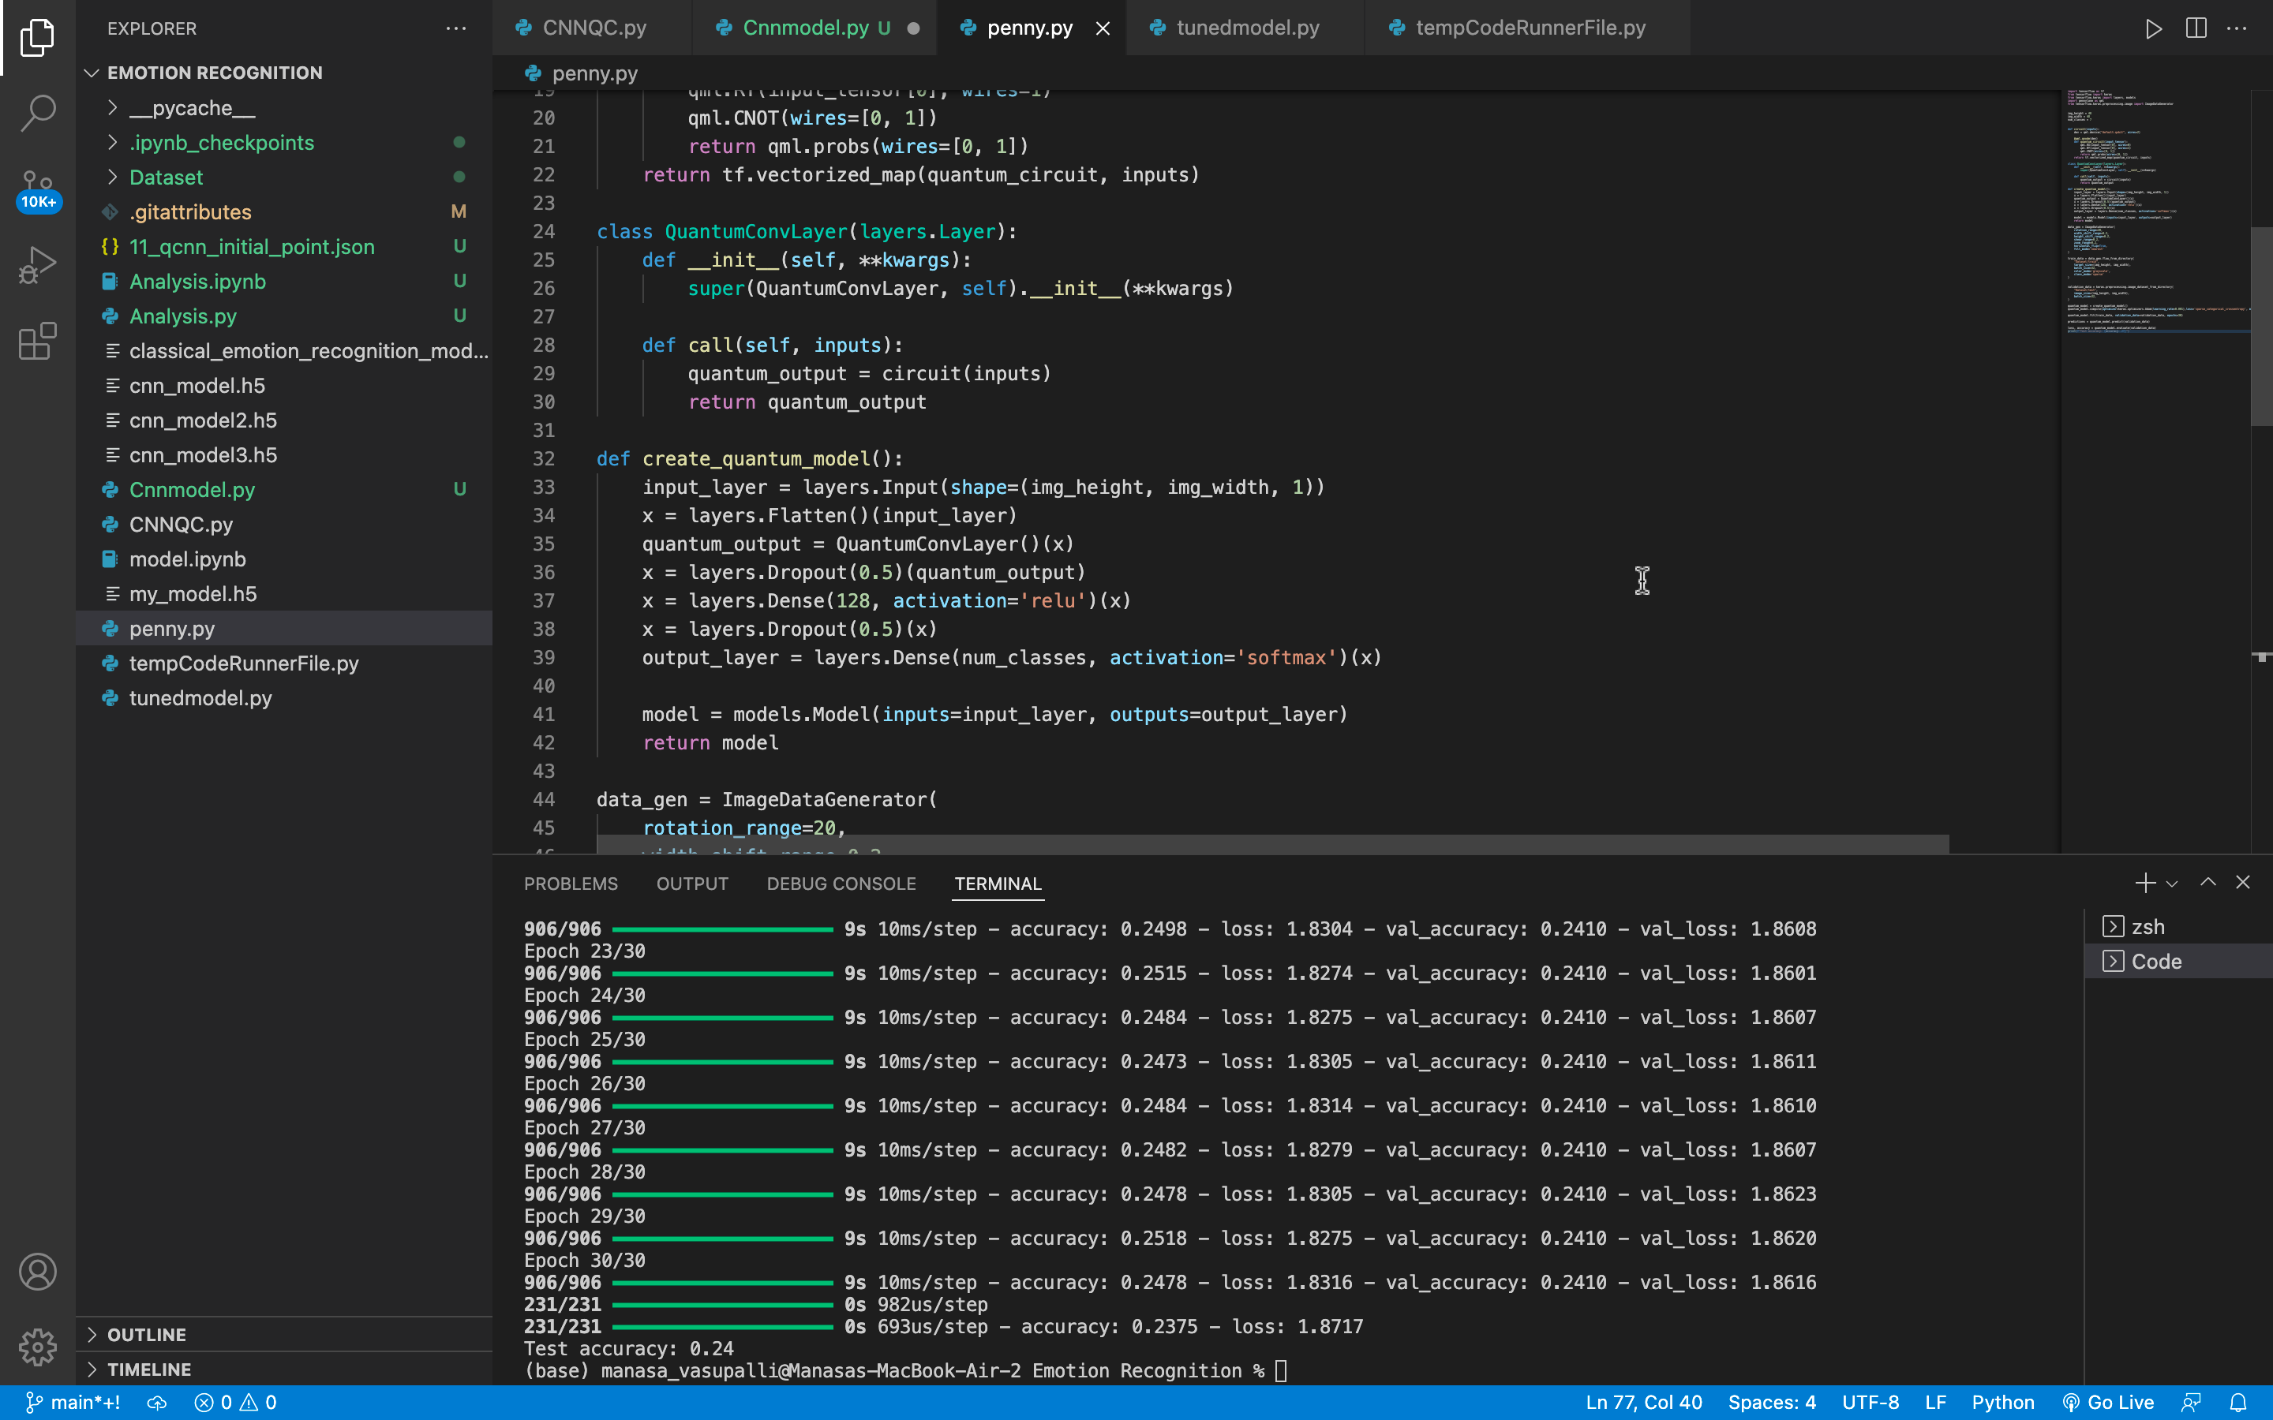
Pennylane model
Used Quadratic Circuits.
Applied RX, RY and CNOT gates for rotation and entanglement .
Complete quantum layers with pennylane library.
Usage of 2 Qubits.
Testing Data accuracy : 24 %

Slide 18
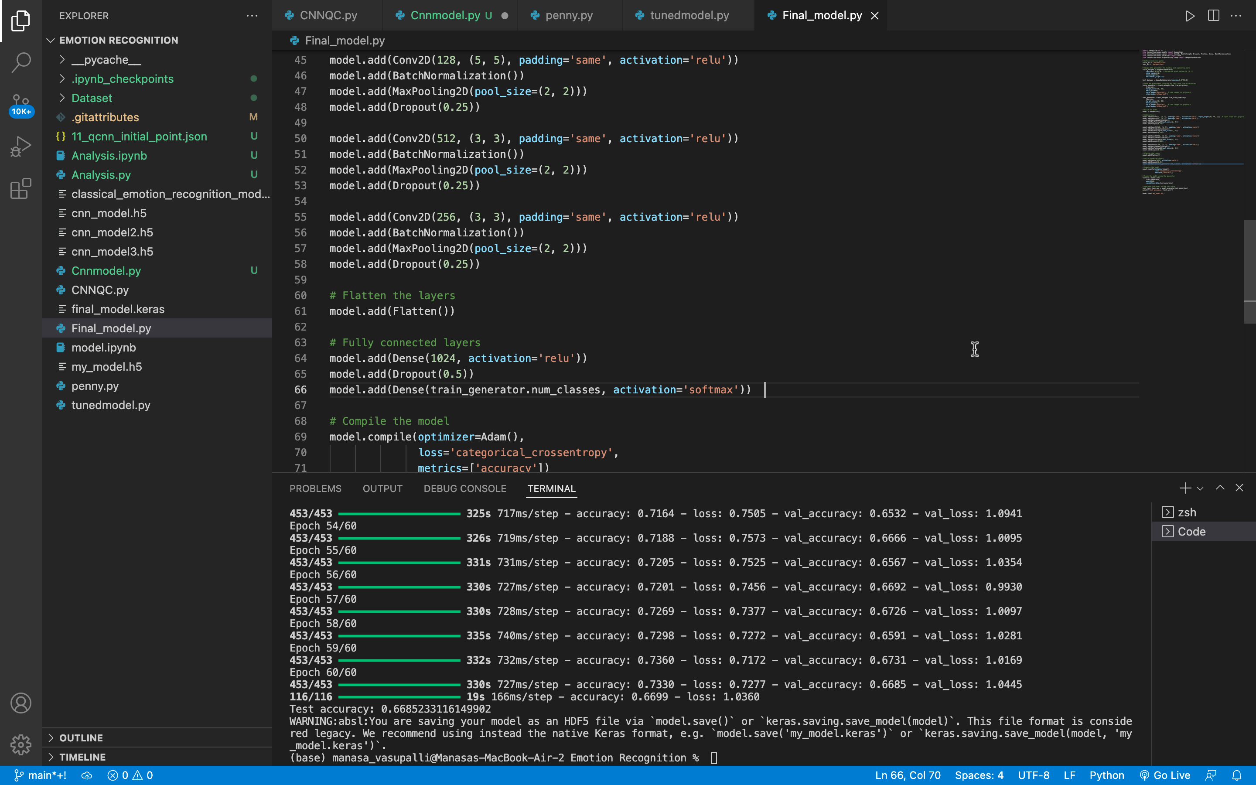
Final model
Implemented CNN with 5 layers .
Increased no of filters
Used BatchNormalization, Max Pooling , Dropouts .
Testing Data accuracy : 66%

Slide 19
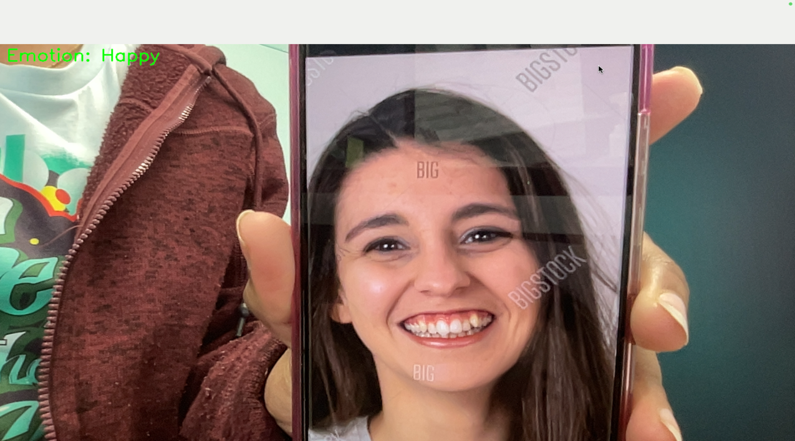
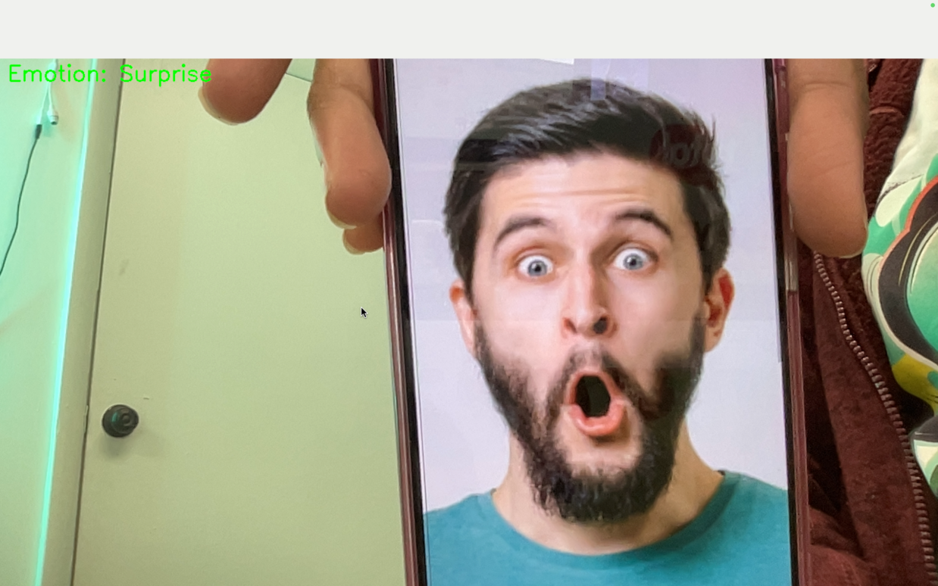
RESULTS
Baseline CNN Accuracy: 60%.
Enhanced CNN Accuracy: 66%.
Quantum Optimization (QUBO): Achieved 40%.
Quantum Circuit Models: Early-stage, accuracy 24%.

Slide 20
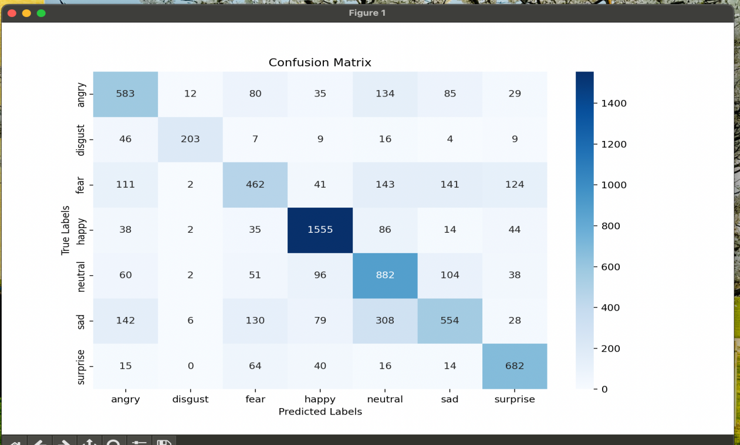
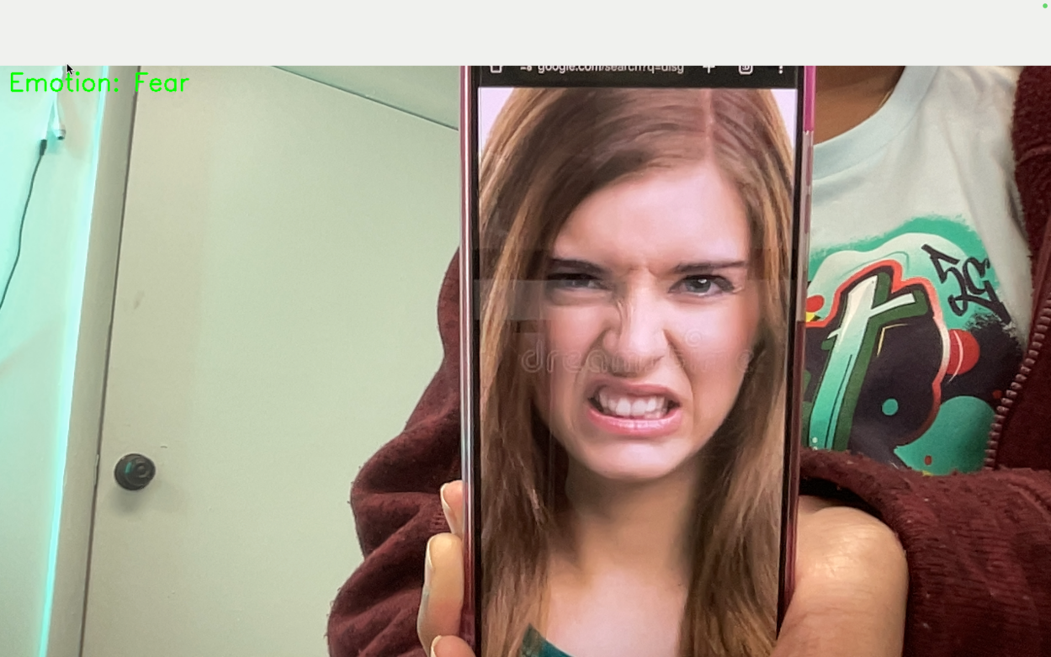
Confusion matrix

Slide 21
Applications
Customer Service: Real-time emotion detection for improved experiences.
Healthcare: Non-invasive emotional monitoring for mental health.
Education: Tracking student engagement in real-time.
Entertainment: Adaptive gaming and media experiences.

Slide 22
Conclusion & Future Work
Deep learning excels in emotion recognition, achieving 66% accuracy.
Quantum techniques show potential but need hardware advancements.
Future Directions:
* Diverse datasets for robust models.
* Optimizing for real-time applications.
* Hybrid classical-quantum approaches.

Slide 23
Summary
Different CNN Architectures models are implemented .
Built an Quantum Circuit model with 2 quibits using pennylane library.
Quadratic Unconstrained Binary Optimization (QUBO) is used for hyperparameter tunning as well as feature selection .
Finalized CNN model which gives 66% accuracy.

Slide 24
Citations
Liao, Y., Hsieh, M. H., & Ferrie, C. (2024). Quantum optimization for training quantum neural networks. Quantum Machine Intelligence, 6, 33. https://doi.org/10.1007/s42484-024-00169-w
Martín-Guerrero, J. D., & Lamata, L. (2021). *Quantum Machine Learning: An Introduction to Quantum Computing and Neural Networks*. Physics Reports, 943, 1-51. https://www.sciencedirect.com/science/article/pii/S0925231221011000#section-cited-by
C. Lavor, L.R.U Manssur, R. Portugal (2003) Grover’s Algorithm : Quantum Database Search. https://arxiv.org/abs/quant-ph/0301079

Slide 25
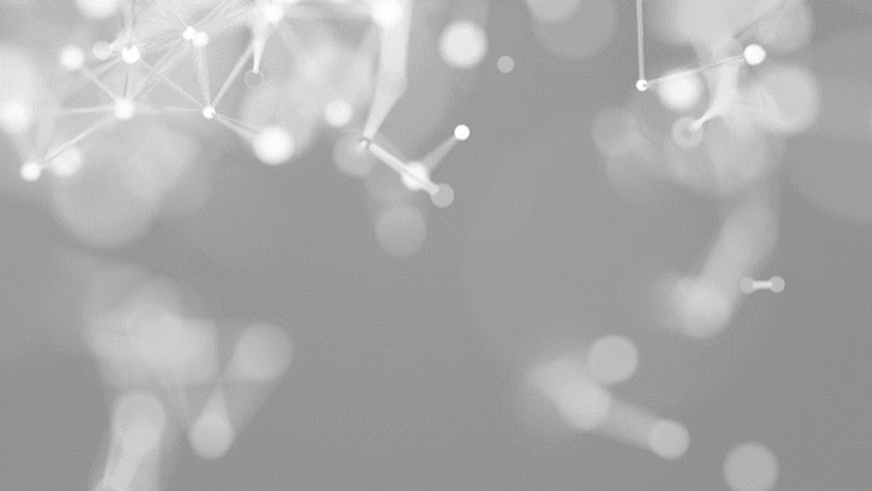
THANK YOU

